Slide 1
Quickhull Algorithm
by Amr Akl

Slide 2
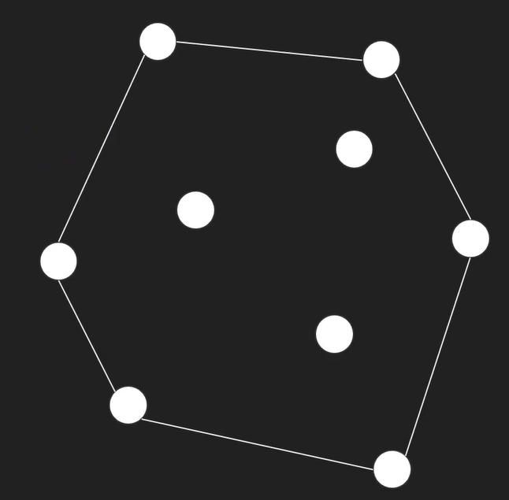
Convex hull
The convex hull problem is a fundamental challenge in computational geometry where the goal is to find the smallest convex shape that encloses a given set of points

Slide 3

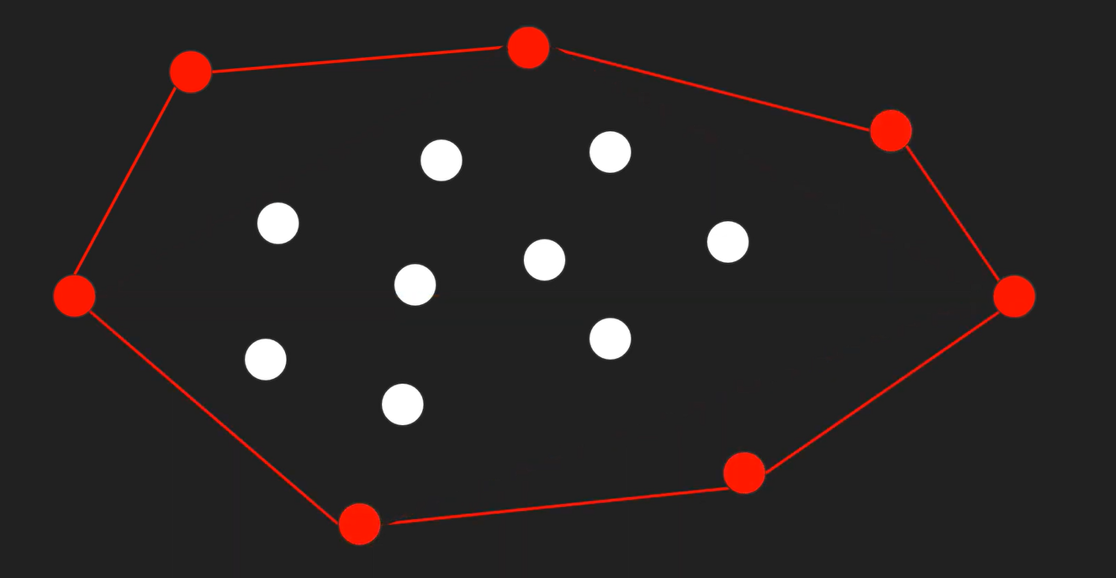
Quickhull

Slide 4
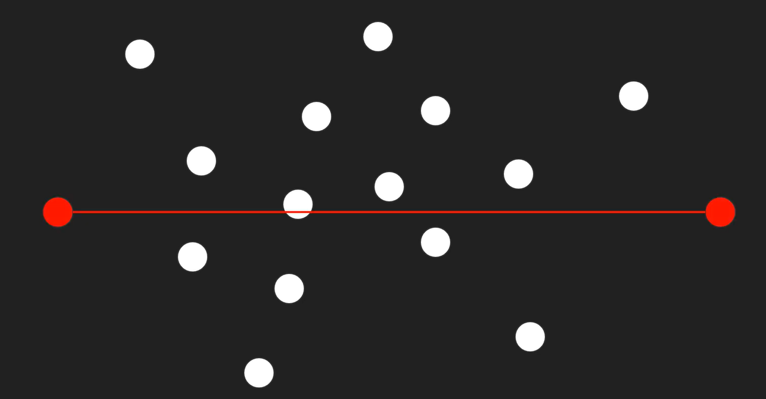
Divide and conquer

Slide 5
Quick hull: Divide and conquer

Slide 6
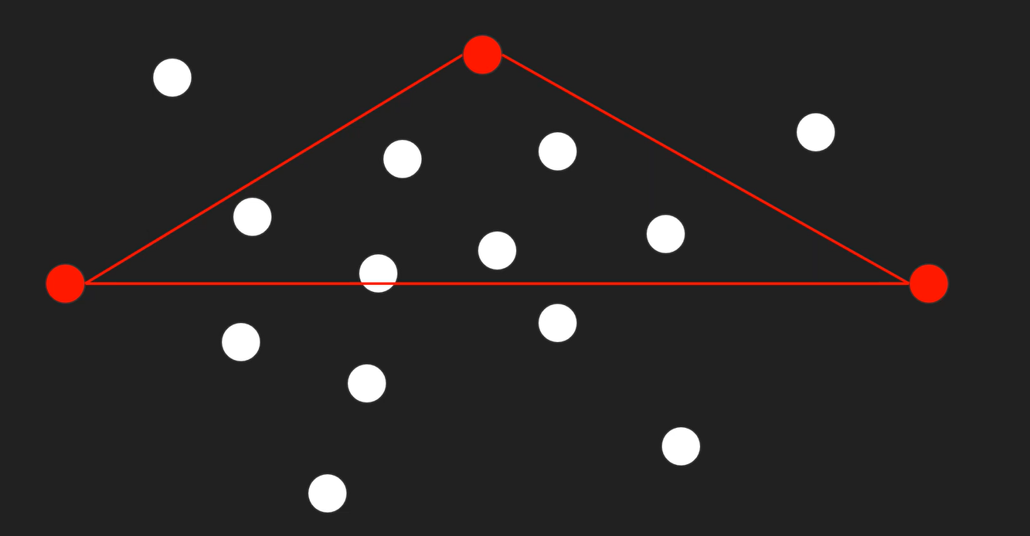
Quick hull: Divide and conquer

Slide 7
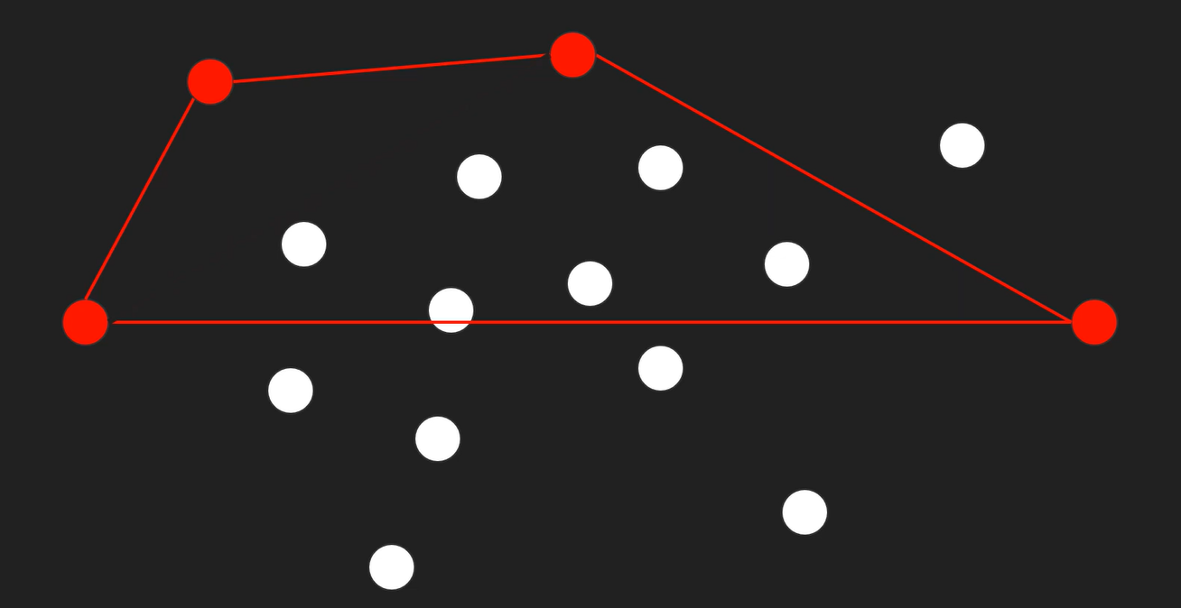
Quick hull: Divide and conquer

Slide 8
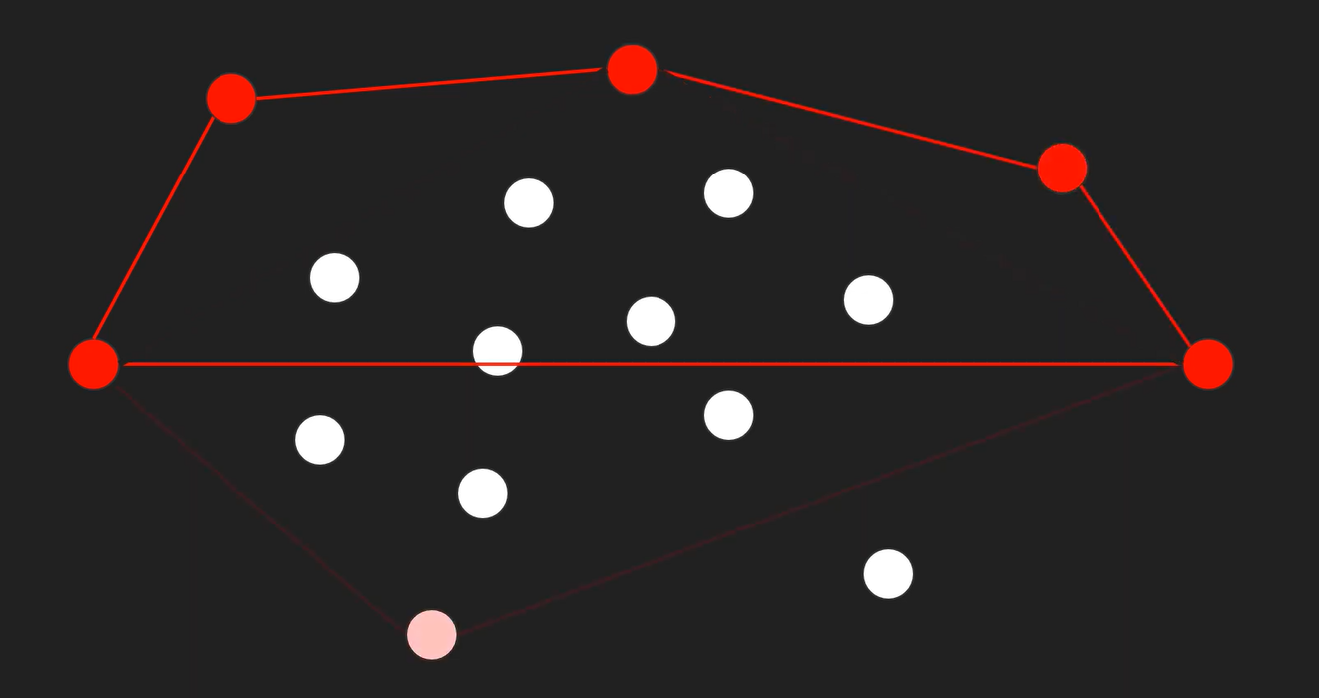
Quick hull: Divide and conquer

Slide 9
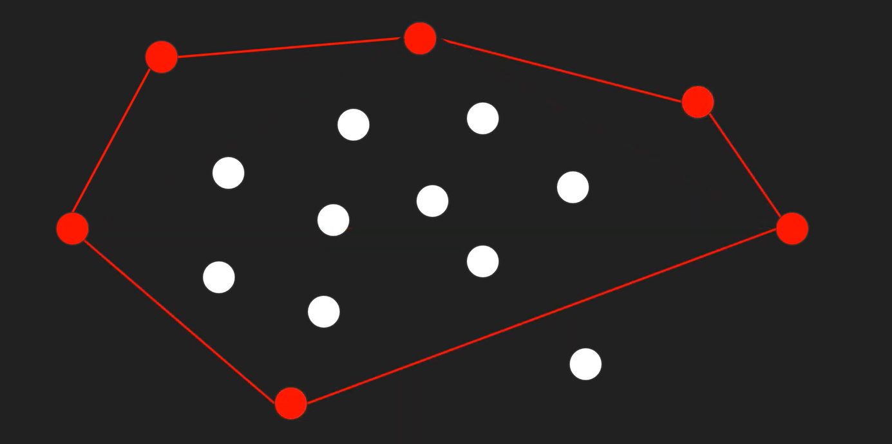
Quick hull: Divide and conquer

Slide 10
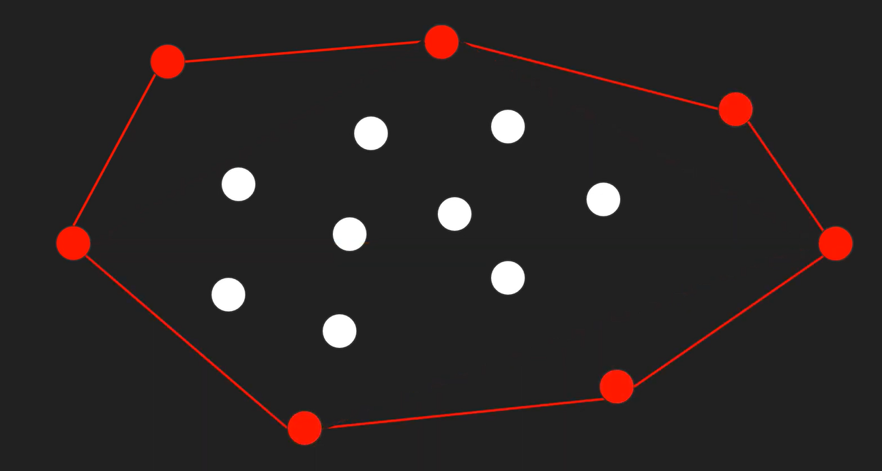
Quick hull: Divide and conquer

Slide 11
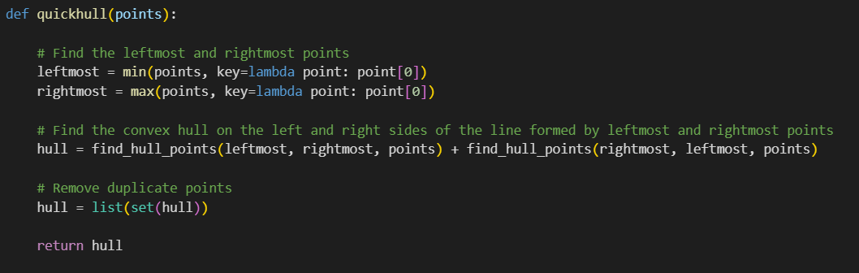
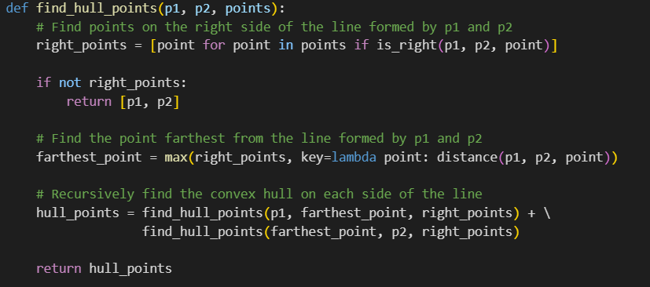
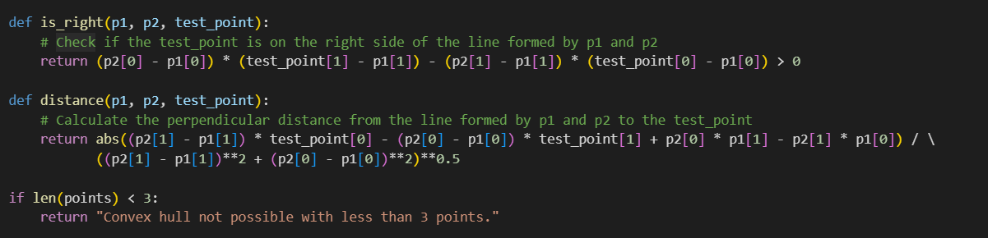
Quick hull: implementation

Slide 12
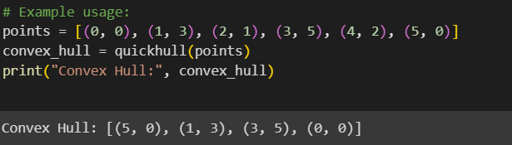
Quick hull: implementation

Slide 13
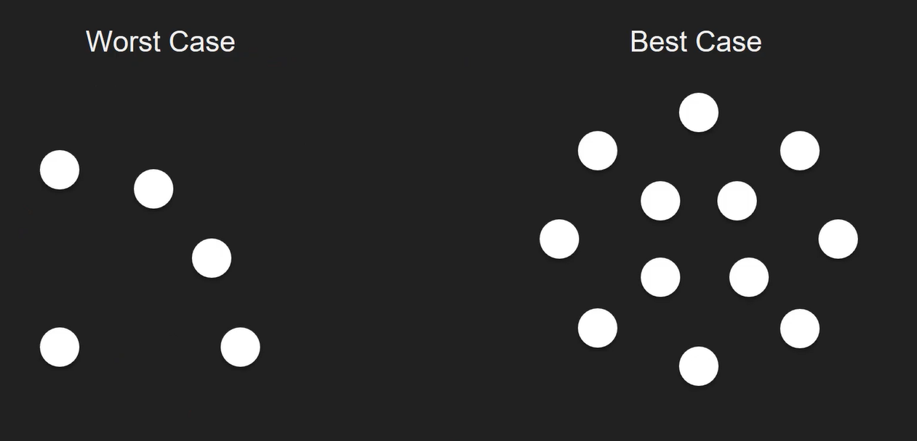
Quick hull: Complexity

Slide 14
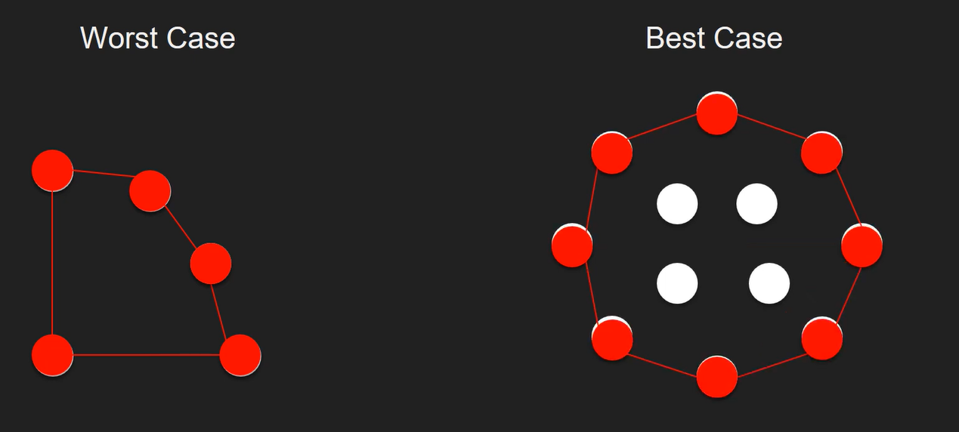


Quick hull: Complexity
O($n^{2}$)
O($n log{n}$)

Slide 15

Quick hull: Complexity

Slide 16




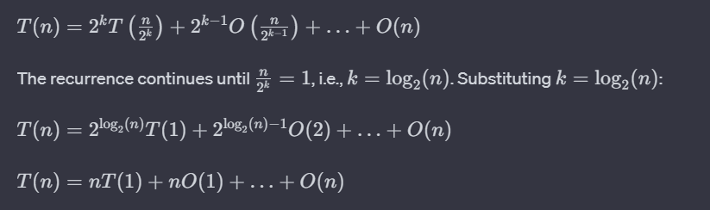

Quick hull: Complexity

Slide 17
Quick hull

